Slide 1


HTML 5
The New Generation of HTML

Slide 2
HTML5
HTML5 will be the new standard for HTML, XHTML, and the HTML DOM.
The previous version of HTML came in 1999. The web has changed a lot since then.
HTML5 is still a work in progress. However, most modern browsers have some HTML5 support.

Slide 3
Why HTML5?
New features should be based on HTML, CSS, DOM, and JavaScript
Reduce the need for external plug-ins (like Flash)
Better error handling
More markup to replace scripting
HTML5 should be device-independent
The development process should be visible to the public

Slide 4
Why HTML5?
HTML5 enables mobile and desktop Web site designers to deliver the advantages of client-side and server-side development to their users simultaneously.
API development and workability in the browsers will leap forward.
HTML5 will have an application cache that is capable of storing all resources in your Web application so that the browser can load them and use them even when you’re offline

Slide 5
New Features
Some of the most interesting new features in HTML5:
The canvas element for drawing
The video and audio elements for media playback
Better support for local offline storage
New content-specific elements, like article, footer, header, nav, section
New form controls, like calendar, date, time, email, URL, search

Slide 6
New Tags
Article
Aside
Figure
Figcaption
Footer
Header
Hgroup
Mark
Meter
Nav
Progress
Section
Details
Summary

Slide 7
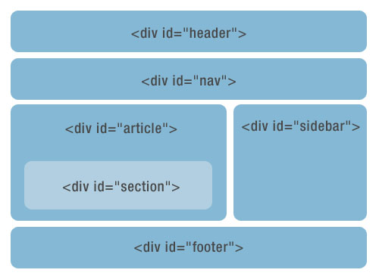
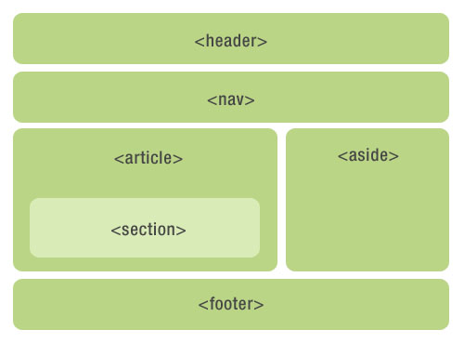
New Tags
HTML4
HTML5

Slide 8

New Input Types
Email
Url
Color
Number
Range
Date
Datetime
Datetime-local
Month
Search
Tel
Week
Datalist
Speech

Slide 9
New Media Elements
<audio> : For multimedia content, sounds, music, or other audio streams.
<video> : For video content, such as a movie clip or other video streams.
<source>: For media resources for media elements, defined inside video or audio elements.
<embed> : For embedded content, such as a plug-in

Slide 10

Browser Support
HTML5 is not yet an official standard, and no browsers have full HTML5 support.
But all major browsers (Safari, Chrome, Firefox, Opera, Internet Explorer) continue to add new HTML5 features to their latest versions.
Opera 9.x - offers best support
Safari 3.x - best support
Firefox 3.x- sketchy
Google Chrome - sketchy
IE8 – sketchy

Slide 11

Question Time

